Slide 1
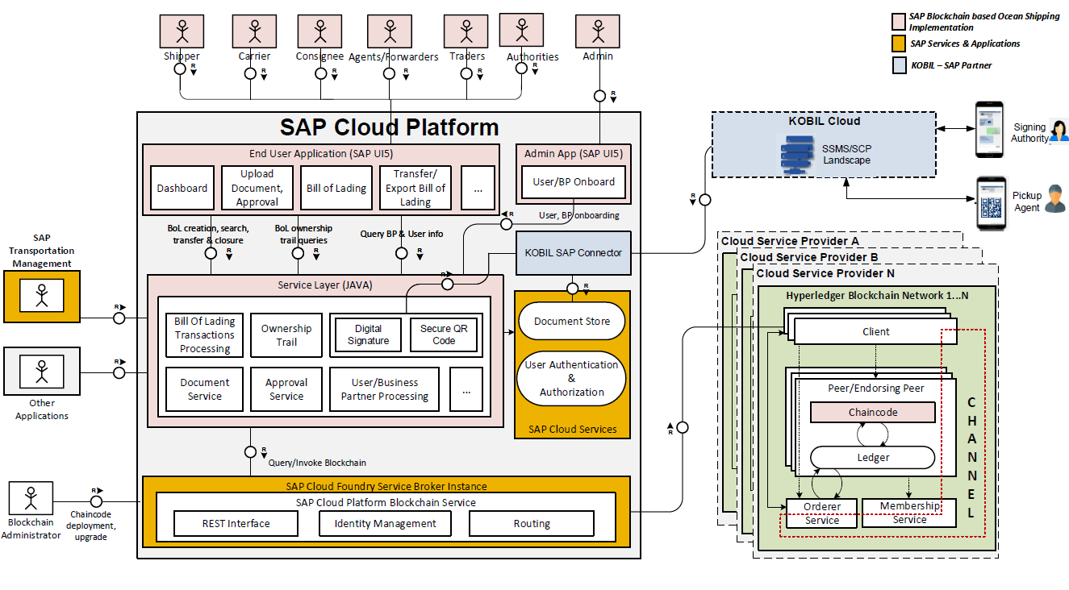
The Architecture of the PoC

Slide 2
Neo / Cloud Foundry

